Slide 1
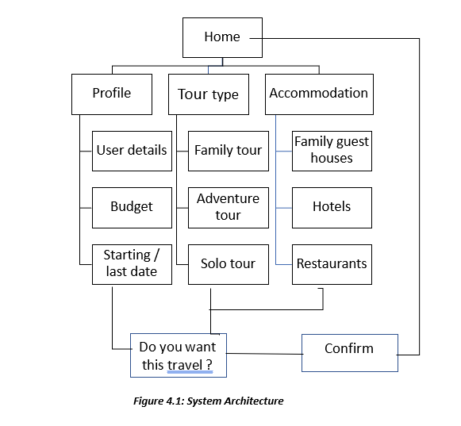
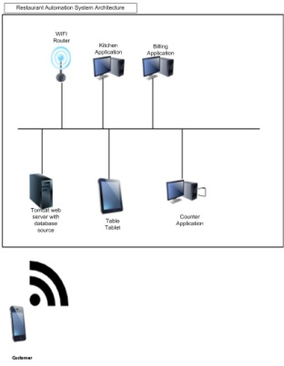
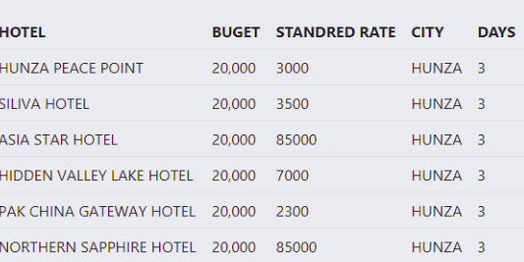
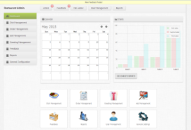
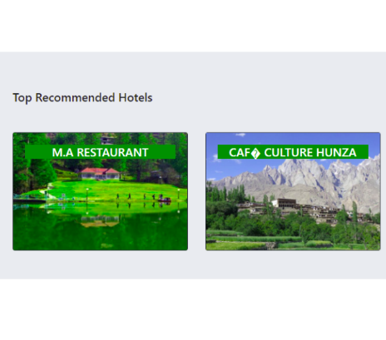
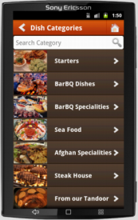

^{Traveler Recommendation} ^{System}
Introduction
In every year, national and international tourist had visited Gilgit Baltistan with families and get worried because of they have no idea about GB places and routes to where to go and where the hotels, hospitals, and they have to face problems
To solve the problem facing by tourist in GB we design and develop this web application for tourist with complete information and suggestions.
It also uses a recommendation system to recommend places & hotels to tourist, finding location with distance and time and also tourist can adjust budget
Motivations
This Traveler recommendation system application will recommend the tourist to select the places according to their interest by recommendation algorithm.
To facilitate tourist to make by interest according to there available budget.
.
System Background
There are some problems with the existing
. No any recommendation system is given
Places are not priorities.
No recommendation and use static map
No involvement of tourist in suggesting places
Architecture
Results
Admin Application
To manage the orders and see the reports.
Conclusion
Our application facilitates the entire task. Complete information about the famous tourist places, hotels, markets, places. Our application also facilitates the user/tourist in recommending the beautiful places, hotels and trip of Gilgit Baltistan, which are according to the interest of the users and according to their budget and their time.
User Application
Browse menu and order the food.
Future Directions
We will add online booking system.
We will expend this application by adding all places within the Pakistan.
We will facilitate tourist in future by providing android application as well.
Objectives
To Guide the tourist by recommend the places according to his/her interest.
Provide the user similarities base recommendation system.
Provide best places, hotels, things to do and type of trip by recommendation.
Information will also provide manually
Muhammad Aziz
Muhammadaziz977@yahoo.com

